Slide 1
Welcome !!
Introduction
  Instructor
  Students
What is Psychology in daily life and specially in Work Environment?

Slide 2
Introduction to Psychology

Slide 3
CR nomination
  Group or individual work
  Presentation schedule
  Case studies / articles
  WhatsApp group
Class Norms

Slide 4
TRUE OR FALSE
Hypnosis can make you forget your own name.
People with mental disorders are always dangerous.
A person's handwriting reveals their personality traits accurately.
Intelligence is solely determined by your IQ score.
Psychics can read your thoughts and predict your future.
Psychologists only deal with mentally challenged people
Psychologist are able to read minds
Power posing increases your confidence hormones (Superwoman pose)
The average person only uses 10 percent of their brain capacity.

Slide 5
Some common questions which psychology addresses
How do we remember, think & reason?
How do drugs alter brain functioning?
What makes us fall in love?
How does learning influence behavior?
What are causes of aggression? How can it be controlled?
How do our genes effect our abilities, personality & behavior?
Which child rearing methods psychologically healthy adults?
To what extent our actions are controlled by unconscious factors?
Can stress kill? What are the effective ways of coping with stress?

Slide 6
What is Psychology?
The scientific study of behavior and mental processes and how they are affected by an organism’s physical state, mental state, and external environment.

Slide 7
Example: Imagine a psychologist conducting a study to understand how anxiety (the mental state) in college students (the organism) affects their performance on exams (behavior) in different settings (external environment).

Slide 8
In this example, the psychologist is scientifically studying the behavior (exam performance) and mental processes (anxiety) of college students and how these are influenced by the students' physical state (e.g., heart rate, cortisol levels), their mental state (anxiety level), and the external environment (e.g., quiet library vs. noisy classroom). The research aims to uncover the relationships between these factors and how they impact the students' academic performance. This exemplifies the scientific study of behavior and mental processes in the context of an organism's physical state, mental state, and external environment.

Slide 9
What is Psychology?
The scientific study of behavior and mental processes and how they are affected by an organism’s physical, state, mental state, and external environment.
Scientific study requires several things:
Theoretical framework
Testable Hypotheses
Empirical evidence

Slide 10
What is Psychology?
The scientific study of behavior and mental processes and how they are affected by an organism’s physical, state, mental state, and external environment.
Behavior and mental processes include overt, observable instances but also include subtle kinds of instances, like brain activity.

Slide 11
What is Psychology?
The scientific study of behavior and mental processes and how they are affected by an organism’s physical, state, mental state, and external environment.
Humans and many other creatures included in the scientific study of behavior and mental processes

Slide 12
What is Psychology?
The scientific study of behavior and mental processes and how they are affected by an organism’s physical state, mental state, and external environment.
Physical state relates primarily to the organism’s biology - most especially the state of the brain and central nervous system

Slide 13
What is Psychology?
The scientific study of behavior and mental processes and how they are affected by an organism’s physical state, mental state, and external environment.
Mental state does not have to be conscious - can study mental states in many creatures without their conscious awareness - and can be studied in terms of brain activity.

Slide 14
What is Psychology?
The scientific study of behavior and mental processes and how they are affected by an organism’s physical state, mental state, and external environment.
All organisms function in an environment that is constantly presenting them with problems and challenges that must be solved.

Slide 15
What is Psychology?
The scientific study of behavior and mental processes and how they are affected by an organism’s physical state, mental state, and external environment.
Most people think of psychology as the study of differences between people, but it also includes the study of similarities between people.

Slide 16
Scope of Psychology
Broad enough to cover every aspect of our lives: memory, social judgments, recognition, obesity, violence, stress, and many more.
It encompasses nature & cause of our every behavior, feelings, motives and thoughts.
Its important role in solving human problems specially in this rapidly changing world.
Behavior is so complex and so personal that its scientific study posses a lot of challenges.

Slide 17
Sub-fields of Psychology
Clinical Psychology:
Clinical psychologists assess, diagnose, and treat individuals with mental health disorders and emotional issues. They use therapeutic techniques to help clients improve their psychological well-being.
Counseling Psychology:
Counseling psychologists work with individuals dealing with everyday life issues, such as relationship problems, stress management, and career concerns. They provide guidance and support to help clients make positive changes.
Educational Psychology:
Educational psychologists study how people learn and develop within educational settings. They work to improve teaching methods, enhance learning outcomes, and address issues related to student motivation and achievement.

Slide 18
Environmental Psychology:
Environmental psychologists examine the relationship between people and their physical environment. They study how the environment affects behavior, well-being, and decision-making, with a focus on topics like sustainability, urban planning, and workspace design.
Forensic Psychology:
Forensic psychologists apply psychological principles to the legal and criminal justice systems. They may assess criminal suspects, provide expert testimony in court, and work on issues related to criminal behavior and rehabilitation.
Experimental Psychology:
Experimental psychologists conduct research to investigate fundamental principles of behavior and cognition. They design and carry out experiments to better understand topics such as memory, perception, learning, and motivation.

Slide 19
Industrial/Organizational Psychology:
Industrial/organizational psychologists focus on workplace issues. They help organizations improve employee performance, satisfaction, and well-being through areas like personnel selection, training, and organizational development.
Social Psychology:
Social psychologists study how individuals are influenced by others and how they perceive, think about, and relate to one another. Topics include attitudes, group dynamics, social cognition, and prejudice.
Sports Psychology:
Sports psychologists work with athletes to enhance their mental and emotional well-being, improve performance, and cope with challenges like competition stress, injury recovery, and teamwork.
Health Psychology:
Health psychologists investigate the psychological factors that influence physical health. They work to promote healthy behaviors, assist with chronic illness management, and study the mind-body connection.

Slide 20
What is Scientific Thinking?
1. Critical thinking - assess claims on the basis of well-supported reasons and evidence - not on emotional or anecdotal reasoning.
2. Involves asking questions - one of the most important is, “WHY?”
3. Involves defining terms - must be clear and concrete
4. Involves examining evidence - “Let me have my opinion!” doesn’t count
5. Involves analyzing assumptions and biases - scientific thinkers do not take anything as proven fact and work hard to overcome their own biases in thinking
6. Involves avoiding emotional reasoning - do not let gut feelings replace clear thinking - emotional conviction does not settle arguments
7. Involves avoiding oversimplification - the obvious answer is often wrong and misleading - do not argue based on own anecdotal evidence
8. Involves consideration of other interpretations - the best interpretations are supported by the most evidence and explain the most variables

Slide 21
What is Scientific Thinking?
9. Involves tolerating uncertainty - sometimes evidence is unclear or does not even exist
10. Involves asking questions that can be tested in this world

Slide 22
What is Scientific Thinking?
What is the difference between these two statements?
1. I like Fords better than Hondas.
2. Fords are better than Hondas.
And what about this statement?
3. Fords are the best in the world and Hondas do not exist; they are a conspiracy of the Japanese government.

Slide 23
Goals of Psychology
Four basic goals:
  To describe how people & living being behave.
  To understand (explain) the causes of each behavior.
  To predict how people will behave under certain conditions.
  To control or influence behavior through knowledge & control of its causes.

Slide 24
Goals of Psychology
Four basic goals: examples
  A child throwing tantrums in mall.
  A consumer buying a specific brand of tea/shampoo
  A manager being bossy!!
  A shy person!!
  An employee being disobedient
  An advertising person making an ad strategy.

Slide 25
Describe:
The child is observed screaming, crying, stomping their feet, and possibly throwing objects or lying on the ground.
Explain:
The child's tantrum may be caused by various factors, such as fatigue, hunger, frustration, or a desire for attention. Understanding the specific trigger is important for addressing the behavior.
Predict:
If you notice that the child consistently throws tantrums when they are tired or hungry, you can predict that they may have similar outbursts in similar situations in the future.
Control:
To address the tantrum, a parent or caregiver might use strategies like offering a snack when the child is hungry, providing comfort when they are tired, or setting clear expectations and boundaries to reduce frustration. These actions are based on the understanding of the tantrum's causes and aim to influence the child's behavior positively.

Slide 26
BASIC and APPLIED RESEARCH
Basic Research: research conducted for the purpose of advancing knowledge rather than for practical application (typically three goals: description, explanation, prediction)
Applied Research: research for the purpose of solving practical problems (typically the fourth goal: to control behavior)

Slide 27

Difference between Psychologists & Psychiatrists
Psychiatrists: They are physicians who specialize in the treatment of psychological disorders. Not all psychiatrists have extensive training in psychotherapy, but as MDs they can prescribe medications
Clinical psychologists: They have PhDs mostly. They are experts in research, assessment, and therapy, all of which is verified through a supervised internship.

Slide 28
History of Psychology

Slide 29
Early roots of Psychology
Early roots can be traced back to ancient Greek & Romans
Half a million years ago – psychological problems were viewed as caused by ‘evil spirits’ – operative procedure ‘Trephining’
Descrates – 17th century philosopher explained nerves were hollow tubes through which animal spirits conducted impulses in the same way as water through pipes.
18th century physician – Franz Gall proposes ‘phrenology’ – the shape & bumps on the skull tells about the personality of the person.

Slide 30
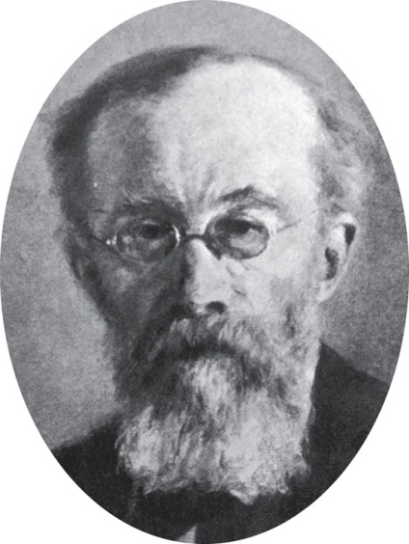
Early perspectives
STRUCTURALISM
In 1879 Wilhelm Wundt established first lab in Leipzig, Germany
  Aim to study building blocks of mind
  His perspective is known as “Structuralism”
  He studied basics of perception, consciousness, thinking, emotions etc.
  “Introspection” – the method used by structuralists to study mind.
  Introspection – people were presented with stimulus and were asked to describe using their own words in as much details as possible what they were experiencing.
At about same time, William James was setting up his lab in Cambridge Massachusetts.

Slide 31
Experimental Setup:
In Wundt's laboratory, a participant would be seated in a controlled environment with an apple placed in front of them. An experimenter trained in introspective techniques would guide the participant through the process.
Introspection Process:
Initial Observation: The participant would be instructed to focus their attention solely on the apple and to describe their inner experiences as they observe it.
Sensory Descriptions: The participant would then proceed to provide detailed introspective reports about their sensory experiences with the apple, one sense at a time:
Sight: "I see a round, red apple with a slightly shiny surface. It has a small green stem at the top."
Touch: "As I pick it up, I feel the apple's smooth and cool surface. My fingers sense the slight texture of the skin."
Smell: "Bringing it closer to my nose, I detect a fresh, fruity aroma."
Sound (if applicable): "When I tap the apple lightly, it produces a dull thud sound."
Internal Thoughts and Feelings: The participant would be encouraged to report any thoughts, emotions, or memories that arise during their observation:
"As I look at this apple, it reminds me of my childhood when I used to pick apples with my family. I feel a sense of nostalgia and warmth."
Continual Observation: The introspection process would continue for a set period, during which the participant would describe any changes in their thoughts, feelings, or sensations related to the apple.
Recording and Analysis: The experimenter would record these introspective reports meticulously and analyze them later. The goal would be to identify common themes and patterns in how individuals experience and describe an apple.

Slide 32
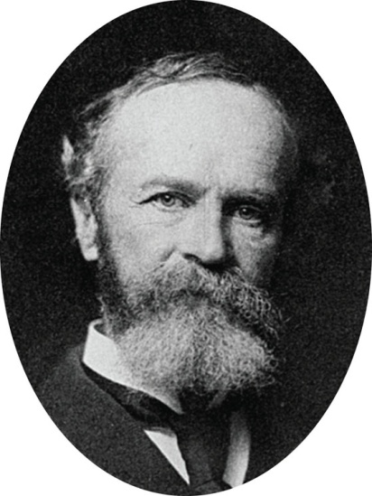
Early perspectives
FUNCTIONALISM
  Instead of focusing on mind’s components, it focuses on what the mind does & how behavior functions
  In early 1900s – led by American psychologist William James
  What roles behavior plays in allowing people to better adapt to their environment, how behavior allows people to satisfy their needs.
  Suggested that when we repeat something several times, our nervous systems are changed so that each time we open a door, it is easier to open than it was last time.

Slide 33

Early perspectives
GESTALT
  Early 1900s
  It focuses on how perception is organized
  Instead of considering individual parts that make up thinking, gestalt took on concentrating on how people consider individual elements together as units or wholes.
  “the Whole is different from the sum of its parts” means that when considered together, the basic elements that compose our perception of objects produce something greater and more meaningful that those individual elements alone.

Slide 34
MODERN PSYCHOLOGICAL PERSPECTIVES

Slide 35
Understanding human behavior using different perspectives
Helping Behaviour

Slide 36
Helping Behavior

Slide 37
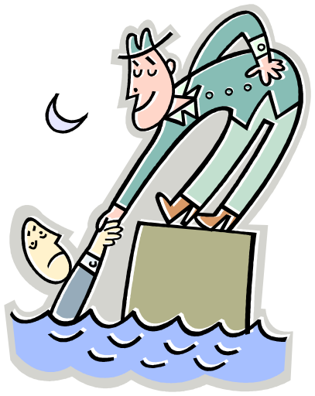
Psychological Perspectives – an example
Behaviour can be viewed from different viewpoints
There are 6 dominant perspectives or ‘schools of thought’
Each will have a different explanation for behaviour
  HELPING BEHAVIOUR: if a person helps a stranger pick up a spilled bag of groceries; why do some people help when others don’t?

Slide 38
Biological Perspective
Tries to understand behaviour by studying the biological structures and substances underlying a certain behaviour, thought or emotion
Explain helping behaviour by a natural ‘feel-good’ chemical in the brain
Those lacking normal amounts of this chemical may be depressed – therefore not help the stranger

Slide 39

Behavioural Perspectvie
Believe we learn certain responses through rewards, punishments and obersvation
Helping behaviour might occur because the person has observed someone being rewarded for helpful behaviour

Slide 40
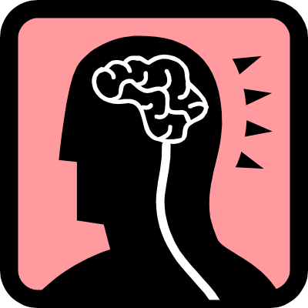
Cognitive Psychology
Focuses on how people think
How we process information
Remembering something you have learned is a cognitive activity
With this perspective – helping a stranger may be due to how we think about or interpret a situation
We may help the shopper because we think it will make us look good to others
Don’t help – may be because we think it will make us look silly

Slide 41
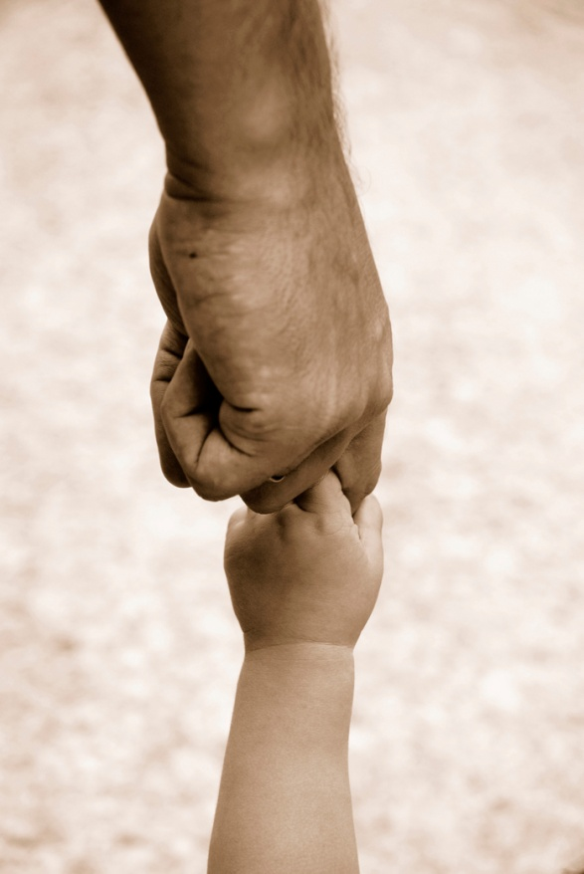
Psychodynamic
Basis from psychoanalytic (Freud)
Consider how our helping behaviour comes from unconscious drives and conflicts
Helping behaviour comes from an unfulfilled childhood wish to have your mom accept your offer to help

Slide 42
Humanistic Perspective
Consider how healthy people strive to reach their full potential
People may help others if they have met their safety and physiological needs (hunger, thirst, shelter)

Slide 43
Integrating Perspectives – three levels of analysis
Biological
Psychological
Environmental
Psycho
dynamic
Behavioral
Biological
Cognitive
Humanistic
Full understanding of behavior involves all the three levels

Slide 44
Integrating Perspectives – three levels of analysis
Biological
Psychological
Environmental
Physiological processes underlie behavior – brain processes, hormones, genetic factors
Analyze the role of thought, memory, planning & problem solving, motivational, emotional, personality processes in the behavior of interest.
Take account of the environment, past & present, personal & cultural that helps shape & stimulates our behavior.

Slide 45
Work Stress at three levels of analysis
Biological
Psychological
Environmental
Stress hormones levels measured at rest & during work
Measure heart rate & respiration rate
Measurement of muscle tension & sweating
Anxiety (self report personality test)
Questionnaire rating of worry, tension & anxiety
Behavioral observations of nervousness during stress like nail biting, foot wiggling
Aspects like: difficult project/task, time pressure, deadlines/targets, noise, heat level
Easy or difficult work assignment & standards
Expectations of organization, supervisor or work colleagues

Slide 46
Consumer Stress at three levels of analysis
Biological
Psychological
Environmental
Stress hormones levels measured at rest & during stress
Measure heart rate & respiration rate
Measurement of muscle tension & sweating
Anxiety (self report personality test)
Questionnaire rating of confusion, worry, tension & anxiety
Behavioral observations of nervousness during making decisions like nail biting, foot wiggling
Aspects like: unlilmited choices, fast changing strategies by organizations, time pressure, noise, heat level
Easy or difficult choices and standards
Expectations of society & people around
Self-expectations

Slide 47
Biological Perspective
It considers biological factors in the study of behavior
  How nerve cells joined together to function biologically
  How the inherited characteristics influence behavior
  How the functioning of body affects hopes, fears
  Which behavior are instinctual
Its contribution is broad in curing mental disorders like amnesia, phobias etc

Slide 48
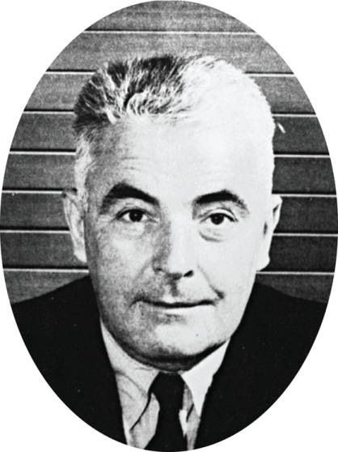
Behavioral Perspective
John B. Watson (1920s)started behavioral approach.
It focuses on observable behavior that can be measured objectively.
Watson stressed that complete understanding of behavior can be done by studying & modifying environment in which people operate.
Its areas of influence are learning processes, treating disorders, curbing aggression etc

Slide 49
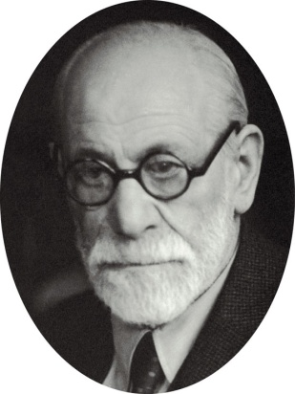
Psychodynamic Perspective
It believes that behavior is motivated by inner forces and conflicts over which we have little or no awareness or control e.g. dreams & slips of tongue result of unconscious psychic activity
Sigmund Freud was a Viennese physician who laid its foundation in early 1900s.
Focus was on ‘unconscious determinants of behavior”
It application is widely criticized but applied in treatment of some psychological disorders, and some everyday phenomena of prejudice and aggression.

Slide 50
Humanistic Perspective
It suggests that all individuals naturally strive to grow, develop and be in control of their lives & behavior. Each of us has capacity to seek & reach fulfillment.
Carl Rogers & Maslow leading humanistic psychologists – people will strive to reach their full potential, if given the opportunity.
The emphasis is on ‘free will’ – the ability to make free decisions about one’s own behavior & life.
Free will is opposed to determinism which sees behavior as caused or determined by things beyond a person’s control.

Slide 51
Cognitive Perspective
It focuses on how people think, understand & know about the world.
Emphasis is on learning how people comprehend & represent the outside world within themselves. How our ways of thinking about world influence our behavior.
In short, thinking is like information processing (decision making model)

